Slide 1


DHANALAKSHMI SRINIVASANENGINEERING COLLEGE
(AUTONOMOUS)
Approved by AICTE, New Delhi & Affiliated to Anna University, Chennai
Accredited with ‘A’ Grade by NAAC
Accredited by NBA with BME, ECE & EEE, Accredited with TCS
Perambalur-621212
FINAL REVIEW
OPTIMIZED FACE MASK RECOGNITION WITH EDGE DEPLOYMENT FRAMEWORK OF GUARD BOT USING DEEP LEARNING
Presented By:
S.Navaneethakrishnan (810419104068)
S.Prasanth (810419104086)
M.Vijay (810419104123)
V.Vishnupriyan (810419104125)
Guided By:
Mrs. R. Aarthy, M Tech., (Ph.D.)
Assistant Professor
Department Of CSE
DATE: 09-05-2023

Slide 2
CONTENTS
ABSTRACT
OBJECTIVE
INTRODUCTION
LITERATURE REVIEW
PROBLEM IDENTIFICATION
EXISTING SYTEM
PROPOSED SYSTEM
HARDWARE & SOFTWARE SPECIFICATION
SYSTEM ARCHITECTURE
MODULE DESCRIPTION
METHODOLOGY
CONCLUSION
FUTURE ENHANCEMENT
REFERENCE

Slide 3
ABSTRACT
To reduce the spread of coronavirus, people often wear masks to protect themselves. This makes face recognition a very difficult task since certain parts of the face are hidden. A primary focus of the researchers during the on going coronavirus pandemic is to come up with suggestions to handle this problem through rapid and efficient solutions. To present a review of various methods and algorithms used for human recognition with a face mask. A comparative analysis is made on these methods to conclude which approach is feasible. With the advancement of technology and time more reliable methods for human recognition with a face mask can be implemented in the future. Finally, it includes some of the applications of face detection.

Slide 4
OBJECTIVE
The main objective of this project is to Fine-tuned CNN is used on our mask/no mask dataset and obtained a classifier that is more than ~95% accurate.
Our face mask detector is accurate, and since we used the CNN architecture, it’s also computationally efficient.

Slide 5
INTRODUCTION
There are so many essential equipment’s needed to fight against the corona virus. One of such most essential is face mask. Firstly, a face mask was not mandatory for everyone but as the day progresses scientists and doctors have recommended everyone to wear a face mask. So to detect whether a person is wearing face mask or not is an essential process to implement in the society currently which can be used for various applications like at the airport, hospitals, offices, schools, etc. This system can be of great importance at airports to detect travelers whether they are wearing a mask or not and at schools to ensure students are wearing a face mask for their safety.

Slide 6
LITERATURE SURVEY
No | Title, Author & Year | Objective | Algorithms/Techniques | Dataset | Findings | Cross Ref
1 | A real time robust facial recognition model for masked face images using Machine learning model, Md Faqaruddin Ahmed,2021. | The most advanced approaches to facial recognition are based on a deep knowledge based on multiple facial samples. | Convolutional Neural Network (CNN) | Masked Face Data Sets (MFDDs) (SMFRD). | Time taken to predict . No alert system. | https://ieeexplore.ieee.org/document/9675936
2. | A Deep Learning Based Light-Weight Face Mask Detector With Residual Context Attention and Gaussian Heatmap to Fight Against COVID-19, Xinqi Fan,2021. | To examine automatic face mask detection based on image analysis. | single-shot light-weight face mask detector | two public datasets, the AIZOO and Moxa3K face mask datasets. | Therefore, the proposed model has a high potential to contribute to public health care and fight against the coronavirus disease 2019 pandemic. | https://ieeexplore.ieee.org/document/9475521

Slide 7
No | Title, Author & Year | Objective | Algorithms/Techniques | Dataset | Findings | Cross Ref
3 | A Novel Detection Framework About Conditions of Wearing Face Mask for Helping Control the Spread of COVID-19, Jun Zhang,2021 | target at detecting the fine-grained wearing state of face mask: face without mask, face with wrong mask, face with correct mask | Context-Attention R-CNN | The MAFA is a masked face dataset, which contains 30, 811 images and 35, 806 masked faces. | e. In the future work, we will explore the imbalance problems and a better attention architecture for more accurate detection on conditions of wearing face mask. | https://ieeexplore.ieee.org/document/9380283
4 | Efficient Transfer Learning Combined Skip-Connected Structure for Masked Face Poses Classification, Senqiu Chen,2020. | Aiming at the new requirements of masked face poses classification during the epidemic outbreak | transfer learning approach | The general face poses dataset comes from the CAS-PEAL-R1 dataset. | In future work, the author aim to study the pose estimation method that is suitable for the objects of faces with and without masks together. | https://ieeexplore.ieee.org/document/9266029

Slide 8
No | Title, Author & Year | Objective | Algorithms/Techniques | Dataset | Findings | Cross Ref
5 | A Novel GAN-Based Network for Unmasking of Masked Face, Nizam Ud Din,2020. | The objective of this work is to remove mask objects in facial images. | GAN-based network using two discriminators. | CelebA dataset and evaluated on real world images collected from the Internet. | This model outperforms others representative state-of-the-art approaches both qualitatively and quantitatively | https://ieeexplore.ieee.org/document/9019697
6 | Facial Mask Detection using Semantic Segmentation, Toshanlal Meenpal,2019. | to design a binary face classifier which can detect any face present in the frame irrespective of its alignment. | Fully Convolutional Networks to semantically segment out the faces present in that image. Gradient Descent is used for training while Binomial Cross Entropy is used as a loss function. | Multi Human Parsing Dataset containing about 5000 images | Along with this it is also able to detect multiple facial masks in a single frame. The post processing provides a large boost to pixel level accuracy. | https://ieeexplore.ieee.org/document/8888092

Slide 9
Problem Identification of Existing System
Algorithm accuracy with masked faces declined substantially across the board.
Masked images more frequently caused algorithms to be unable to process a face, technically termed “failure to enrol or template” (FTE).
The more of the nose a mask covers, the lower the algorithm’s accuracy.
While false negatives increased, false positives remained stable or modestly declined.
The shape and color of a mask matters. Algorithm error rates were generally lower with round masks. Black masks also degraded algorithm performance in comparison to surgical blue ones, though because of time and resource constraints the team was not able to test the effect of color completely.

Slide 10
EXISTING SYSTEM
A large number of intelligent models for masked face recognition (MFR) has been recently presented and applied in various fields, such as masked face tracking for people safety or secure authentication.
Exceptional hazards such as pandemics and frauds have noticeably accelerated the abundance of relevant algorithm creation and sharing, which has introduced new challenges.
Therefore, recognizing and authenticating people wearing masks will be a long-established research area, and more efficient methods are needed for real-time MFR.

Slide 11
Disadvantages
The accuracy of the system is not 100%.
Face and mask detection and loading training data processes just a little bit slow.
It can only detect face from a limited distance.
The instructor and training set manager still have to do some work manually.

Slide 12
PROPOSED SYSTEM
Propose a model that uses MRCNN architecture to recognize the faces with mask.
Region Proposal Network is used to detect the face.
Localized algorithm is used to draw bounding box .
Alert System is used to warn the person to wear mask.
The proposed model requires less memory, making it easily deployable for embedded devices used for surveillance purposes.
MRCNN- Mask RCNN
RPN- Region proposal network

Slide 13
Advantages
The detection speed and accuracy have been greatly improved.
Greatly reduced the computational complexity.
Accurately predict the Face and Face mask.
Alert Generation
Attendance System

Slide 14
HARDWARE CONFIGURATION & SOFTWARE SPECIFICATION
HARDWARE REQUIRMENTS
Processors : Intel® Core™ i5 processor & Later
Disk space : 320 GB
Operating systems : Windows® 10
Monitor :15 Inches
SOFTWARE REQUIRMENTS
Server Side : Python 3.7.4(64 or 32-bit)
Client Side : HTML, CSS, Bootstrap
IDE : Flask 1.1.1
Back end : MySQL 5.
Server : Wamp server 2i
Packages : TensorFlow, Pandas, NumPy

Slide 15
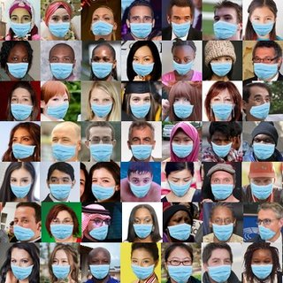

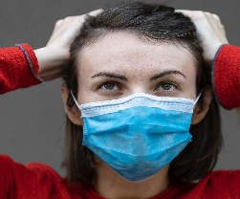


SYSTEM ARCHITECTURE
Facial Emotion Data Set
Training Phase
Live Video from webcam
Mask
Testing Phase
No Mask
Admin
End User
Preprocessing
Segmentation
Feature Extraction
Preprocessing
Classification
Segmentation
Classified File
Feature Extraction
Storage server
Office Application Layer
Office Storage Server
Prediction
Notification SMS or Email
Face Mask
Face No Mask
Face Not Recognized

Slide 16
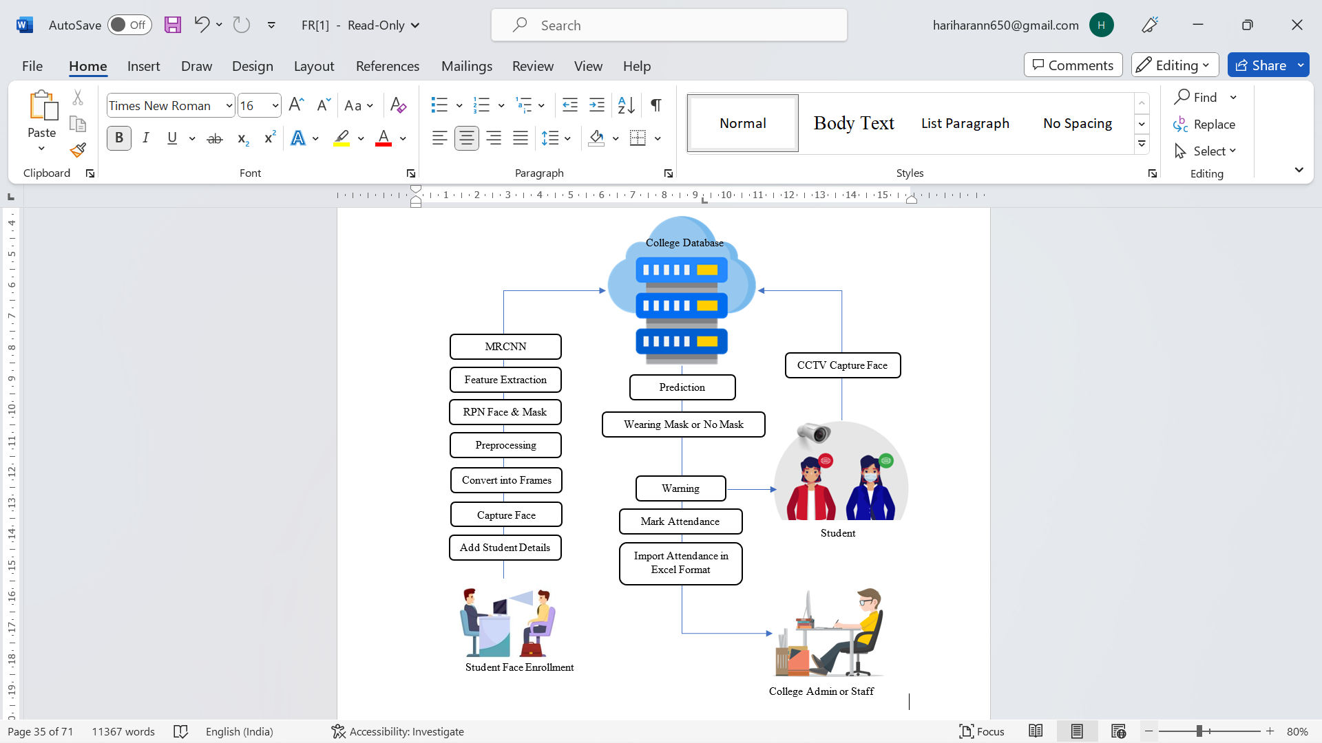

Slide 17
LIST OF MODULES
The Facemask Recognition using convolutional neural network and deep neural network algorithms, is implemented which includes several steps Image Acquisition, Image Pre-processing, Feature Extraction and Disease Classification.
College Dashboard
Dataset Annotation
Pre-processing
Face Detection Segmentation
Feature Extraction
M-RCNN Face Mask Classifier
Performance Evaluation of Model
Face Mask Detector
Attendance System
Warning System
Door open

Slide 18
MODULES DESCRIPTION
College Dashboard
In this module we developed web browser-based interface designed to be used by college admin, Teaching Staff and Student– untrained in data science – to predict and detect face with mask and no mask for attendance System.
1.1.Dataset Annotation
FMR Data acquisition, as the basic step of recognition process, aims to collect a large amount of data both in size and type by a variety of ways.

Slide 19
2. Pre-processing
Image preprocessing are the steps taken to format images before they are used by model training and inference.
The steps to be taken are :
Read image
RGB to Grey Scale conversion
Resize image
Original size (360, 480, 3) — (width, height, no. RGB channels)
Resized (220, 220, 3)
Binarization
Image binarization is the process of taking a grayscale image and converting it to black-and-white, essentially reducing the information contained within the image from 256 shades of gray to 2: black and white, a binary image.

Slide 20
3. Face Detection-Segmentation
Therefore, in this module, Region Proposal Network (RPN) generates RoIs by sliding windows on the feature map through anchors with different scales and different aspect ratios.
Face detection and segmentation method based on improved RPN.
3.1 Feature Extraction
After acquiring the key frames of faces, a deep feature representation of facial features is generated from a 2D-CNN.
This layered architecture allows extracting high-level, medium-level, and low-level features of face expression.
Instead of acquiring features from just the last layer, features are extracted from convolution, pooling, and regularization layers.
25/10/2021
Batch Id:12 SRIT
6

Slide 21
3.2. M-RCNN Face Mask Classifier
Mask R-CNN adds a mask branch for predicting segmentation masks on each Region of Interest (RoI), which can fulfil both detection and segmentation tasks.
After the face mask detector has been trained, we charge the mask detector, perform face recognition, and then decide whether each face is equipped with or without a mask.

Slide 22
3.3 PERFORMANCE EVALUATION OF MODEL
Confusion Matrix
The confusion matrix is an important matrix to create to find the precision, F1 score, specificity, sensitivity, and accuracy. A confusion matrix is used to find the False Negative, False positive, True Negative, and True positive values of the prediction of the trained model. To explain how effectively a categorization system performs, a confusion matrix is utilized. A confusion matrix displays and summarises the effectiveness of a classification method. True positive: The cases where we predicted as COVID-19 and even actually it is the positive case. True positive prediction is 389.
True negative: The cases where we predict as Non-COVID-19 and even actually it is a negative case. True negative prediction is 364.
False positive: The cases where we predict COVID-19, but it is a negative case. The false positive prediction is 36.

Slide 23
False negative: The case where we predict Non-COVID-19, but it is a positive case. The false negative prediction is 11.
Accuracy
The statistics known as accuracy are used to evaluate the effectiveness of classification and regression algorithms. The accuracy value for the proposed model is 94 percent.
Accuracy = (TP + TN) / (TP + TN + FP +FN)
= (389 + 364) / (389 + 364 + 36 + 11)
= 0.94125
Precision
Precision is a measure of how well the suggested model classified the positive photos. The number of true positives divided by the number of true positive predictions is an indicator of the model's success and is explained by the number of positive predictions produced. The precision value of the proposed model is 91 percent.

Slide 24
Precision = TP / (TP + FP)
= 389 / (389 + 36)
= 0.915
Recall
Recall refers to positive findings that are correctly classified as positive. What it is referred to as is a real positive rate. The Recall value of the proposed model is 97 percent.
Recall = TP / (TP + FN)
= 389 / (389 + 11)
= 0.97
Specificity
It looks that how effectively the model predicts negative outcomes. Similar to sensitivity, but from the perspective of undesirable outcomes, is specificity. The specificity value of the proposed model is 91 percent

Slide 25
Specificity = TN / (TN + FP)
= 364 / (364 + 36)
= 0.91
F1 Score
The "harmonic mean" of sensitivity and precision is the F-score. It considers both false-positive and false-negative cases and is appropriate for datasets with imbalances. The proposed model has an F1 score of 94 percent.
F1 Score = 2 * ((precision * sensitivity) / (precision + sensitivity))
= 2 * ((91 * 97) / (91 + 97)
= 0.94

Slide 26
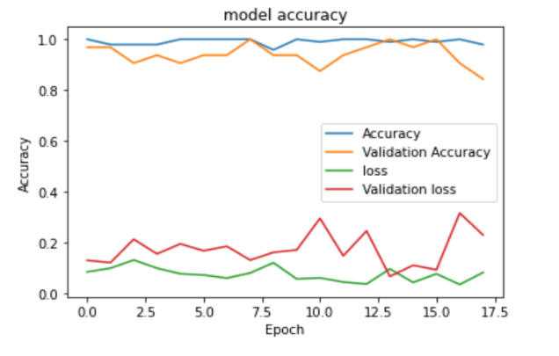
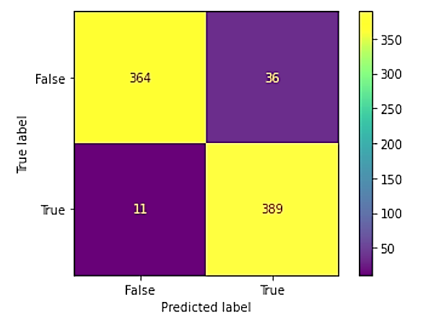
Accuracy and loss graph
Confusion Matrix

Slide 27
4. Face Mask Detector
In this module the matching process is done with trained classified result and test Live Camera Captured Classified file.
4.1. Attendance System
After the verification of faces and successful recognition is done, the attendance of the student is marked in front of his/her roll number. If the face is not recognized, an error page is displayed
It involves the attendance report generation. The module takes student information and daily attendance status from student database. The attendance reports are generated and saved in a file.
4.2. Warning System
In this module, warning message is generated to warn the students to wear mask.

Slide 28
5. Door Open
The door can be opened by face recognition, password. And it can also be equipped with IC/ID card induction to open the door. Built-in dual infrared high-power fill light, no fear of night, dark light or night can be identified.3 attendance output modes, 2000 face capacity, 200,000 attendance record.
An automatic door opening and closing system opens a door by driving means when a person approaches the door.

Slide 29
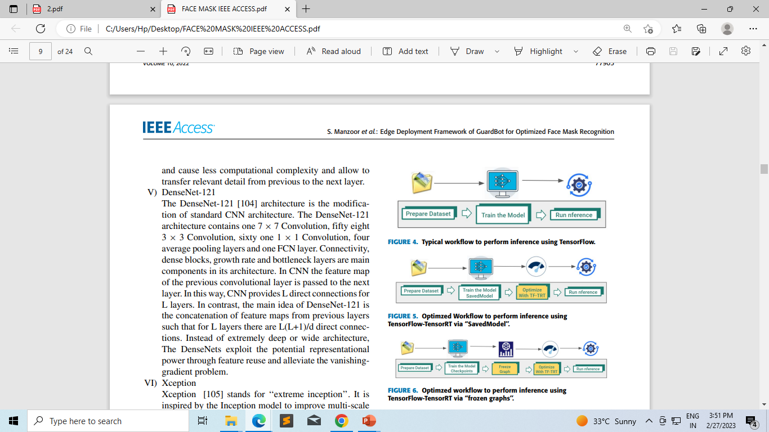

Slide 30
METHODOLOGY
MASK RCNN(Tensorflow 2)
Dataset prepration
Model training
Model testing
Plot confusion matrix
Plot precision and recall curve
Working:
It will take input image and provide output image with mask,bounding box,class lables.
Stage 1:
Feature extractor:
To extract the feature from the input image and we can extract by resnet50 and they are input for RPN.

Slide 31
Region proposal network(RPN)
Regions are area (bounding boxs).
It act like binary classifier and used to check the object present in the region or not.
Present 1
Not present 0
Stage 2 :
Object Detection
Provide bounding boxes and class lables to each object.
The algorithm extracts a fixed-size feature map from each region proposal using RoI (Region of Interest) pooling. These feature vectors are then used for object classification and segmentation.
Stage 3 :
Mask Prediction
Generate binary mask for object.
The Mask R-CNN algorithm is trained on annotated images, where each object instance is labeled with a bounding box and a pixel-level mask.

Slide 32
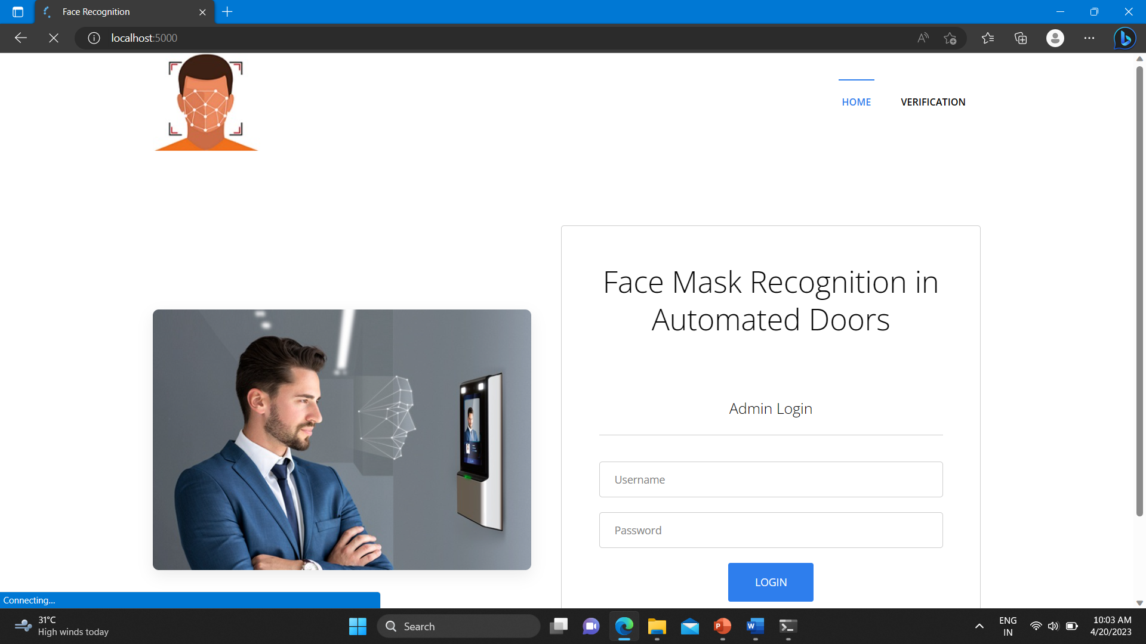
SCREEN SHOT:
IMPLEMENTATION:
Fig.No: A.1 HOME PAGE

Slide 33

Fig. No: A.2 ADD EMPLOYEE DETAILS

Slide 34
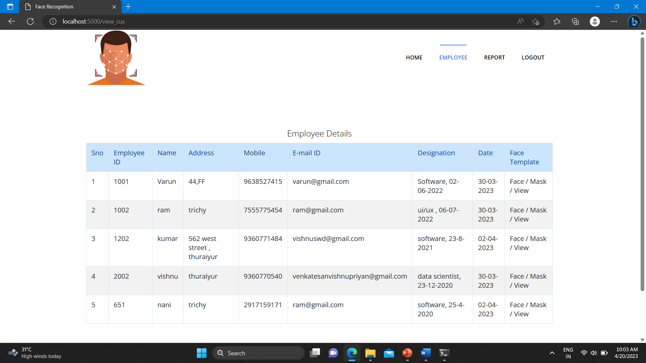
Fig.No: A.3 EMPLOYEE DETAILS

Slide 35
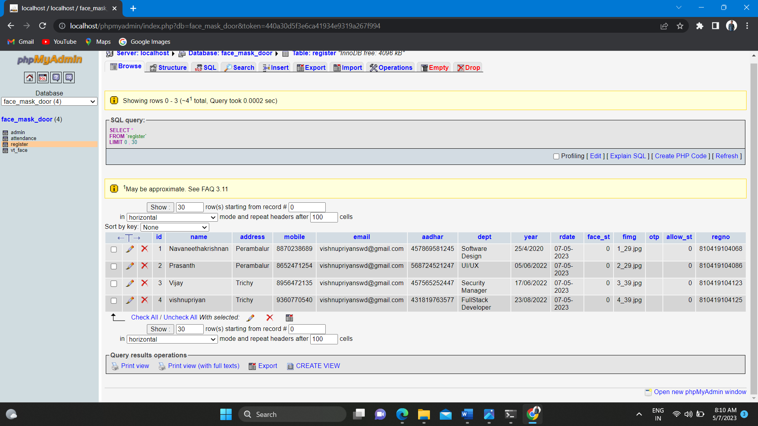
Fig. No: A.4 ADMIN PAGE

Slide 36
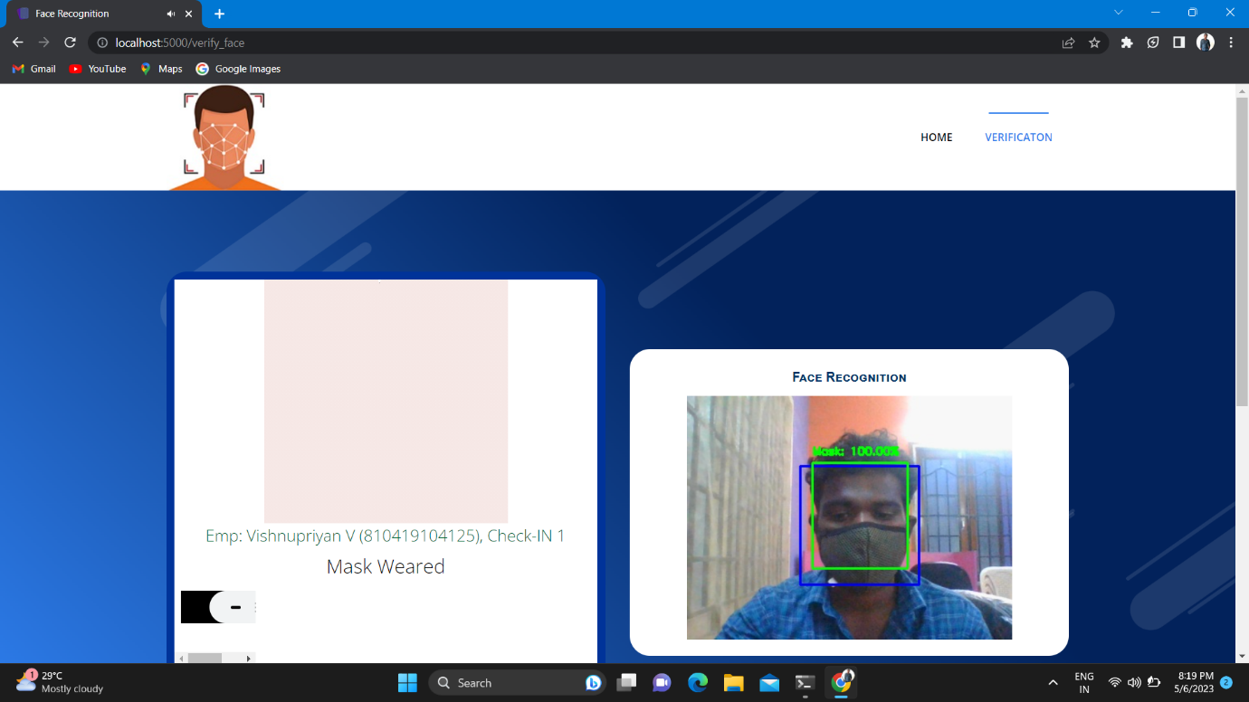
Fig.No: A.5 OUTPUT FACE MASK WEARED

Slide 37
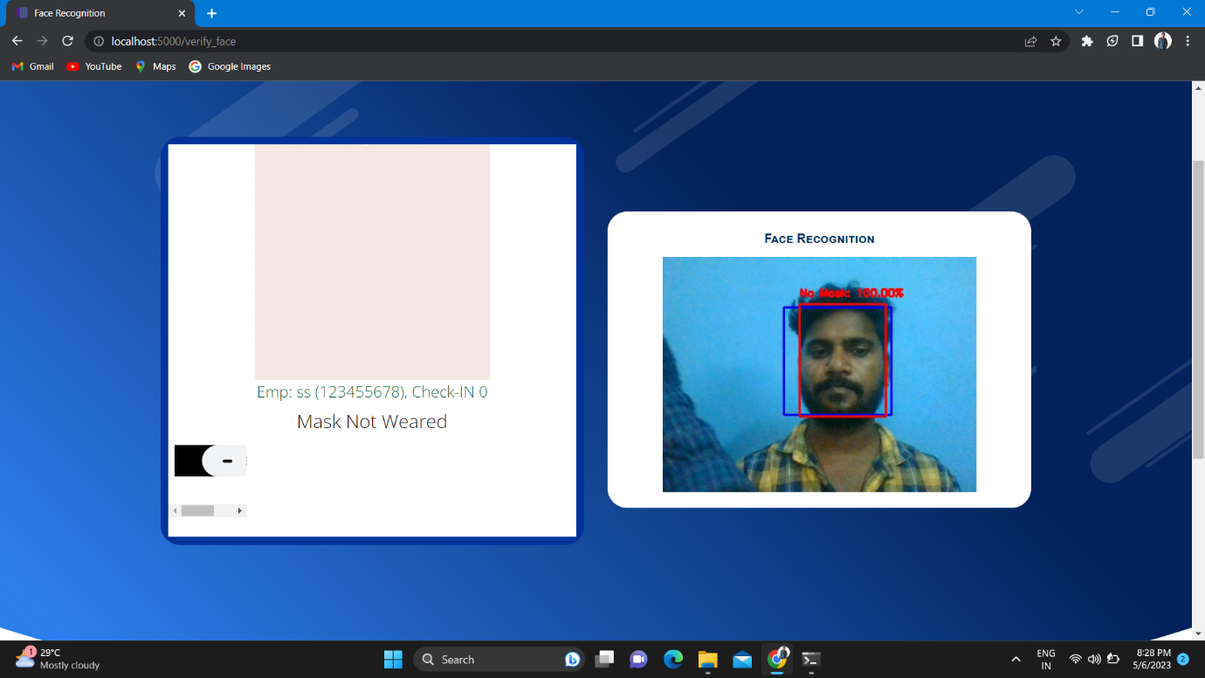
Fig. No: A.6 OUTPUT FACE MASK NOT WEAR

Slide 38
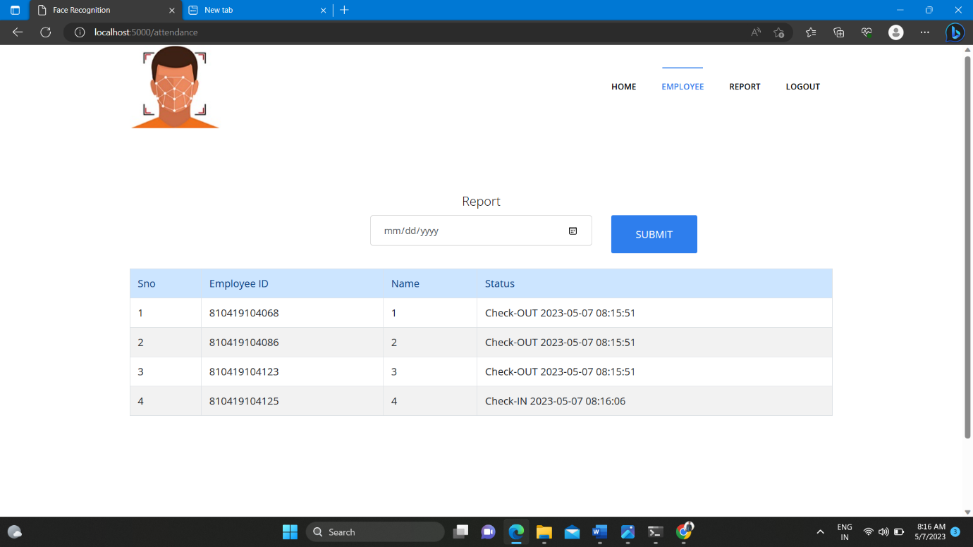
Fig.No: A.7 EMPLOYEE ATTENDANCE

Slide 39
CONCLUSION
Under the spread of COVID-19 pandemic, wearing a protective face mask has become a normal and requirement for many public services, colleges and essential business providers. Both WHO and CDC also stress on the importance and effectiveness of wearing correct masks for personal and public health. Therefore, face mask detection and facial recognition with a mask are essential for our society. To serve the above purpose, this paper proposed a Face Mask Detection and Facial Recognition with Mask System for access, attendance and health check under the pandemic. In this project, a Mask Region Convolutional Neural Network method was proposed for face detection and recognition with mask or no masked face. The system and the solution can be easily used by small businesses, organizations and universities with minimum cost under the COVID-19 and help to practice social distancing.

Slide 40
FUTURE ENHANCEMENT
In future work, we would like to build face mask detection datasets with no, correct and incorrect mask wearing states, or use a zero-shot learning approach to make the model able to detect incorrect mask wearing states.
New deep learning detectors may be used to further improve the performance.
Future enhancements could focus on ensuring that the technology can be easily integrated with a variety of systems and platforms.

Slide 41
REFERENCES
R. Ramachandra, A. Kuijper, P. Fang, C. Zhang, F.Wang, and D. Montero, (2021) “Masked face recognition competition,'' in Proc. IEEE Int. Joint Conf. Biometrics (IJCB)”.
Ritesh Sinha, Puneet Kumar Tiwari, Srijan Kumar Yadav, Prabhash Pandey ,(2022 )"Face mask recognition system using CNN model ".
S. Luo, X. Li, R. Zhu, and X. Zhang, (2021)``SFA: Small faces attention face detector,'' IEEE Access, vol. 7, pp. 171609171620.
Shilpa Sethi , Mamata Katharina , Trilok Kaushik , (2021) "Face mask detection using deep learning: An approach to reduce risk of Coronavirus spread".
Anwar.A and A. Raychowdhury,(2020)``Masked face recognition for secure authentication'' , arXiv:2008.11104.
Bing Shu Wang, Jianbing Zheng, and C.L. Philip Chen , (2021)" A Survey on Masked Facial Detection Methods and Datasets for Fighting Against COVID-19 ".

Slide 42
C. Li, S. Ge, D. Zhang, and J. Li, (2020)``Look through masks: Towards masked face recognition with de-occlusion distillation,'' in Proc. 28th ACM Int. Conf. Multimedia, pp. 3016-3024.
Guanhao Yang , Wei Feng , Jintao Jin , Qujiang Lei , Xiuhao Li , Guangzhou Gui(2020) "Face Mask Recognition System with YOLOV5 Based on Image Recognition ".
Y. Martindez-Diaz, L. S. Luevano, H. Mendez-Vazquez, M. Nicolas-Diaz, L. Chang, and M. Gonzalez-Mendoza, (2021)``Shuffle Face Net: A lightweight face architecture for efficient and highly-accurate face recognition,'' in Proc. IEEE/CVF Int. Conf. Computer. Vis. Workshop (ICCVW), pp. 1-8.
Y. Martinez-Diaz, M. Nicolas-Diaz, H. Mendez-Vazquez, L. S. Luevano, L. Chang, M. Gonzalez-Mendoza, and L. E. Sucar, (2021),”Bench marking lightweight face architectures on specific face recognition scenarios,”Artif. Intell. Rev., vol. 54, pp. 6201-6244 .

Slide 43
Thank You

